Slide 1


EE363-MACHINE LEARNING PROJECT
LSTM BASED SOFT-SENSOR FOR ESTIMATING NITRATE CONCENTRATION IN AQUAPONICS FARMING
PROJECT GUIDE
TEAM MEMBERS
DR.SRI PHANI KRISHNA KARRI
1.SAVADA RAKESH REDDY-521236
2.PANDALANENI MANIKANTA-521209
3.PEDDAPROLU PAVAN-521211

Slide 2
INTRODUCTION
In aquaponics, monitoring nitrate levels is crucial for aquatic and plant well-being. Traditional methods are costly and time-consuming. To address this, an LSTM-based soft sensor was developed. LSTM effectively models nitrate concentration changes in aquaponics, achieving a remarkable MSE of 0.00074 and an R-squared score of 0.98. This solution holds potential for commercial applications, benefiting aquaponics operations, supporting researchers, and enhancing sustainability.

Slide 3
PROBLEM STATEMENT
Aquaponics integrates growing plants without soil technology with aquaculture, having an important role in recovery of nutrients from effluents. Develop a method for accurate and real-time monitoring of nitrate concentration in aquaponic systems. The monitoring of nitrogen content in aquaponics relies heavily on human judgment, which can be subjective and lead to suboptimal harvests. This project proposes an LSTM-based soft-sensor to address this issue by leveraging deep learning techniques to analyze sensor data and estimate nitrate levels in real-time.

Slide 4
DATA SET
The enclosed datasets are generated from freshwater aquaponics catfish ponds. The datasets are generated automatically at 5 seconds intervals using the following water quality sensors driven by the ESP 32 microcontroller: Dallas Instrument Temperature sensor (DS18B20), DF Robot Turbidity sensor, DF Robot Dissolved Oxygen sensor, DF Robot pH sensor V2.2, MQ-137 Ammonia sensor, and MQ-135 Nitrate sensor.
The project is funded by the Lacuna Award for Agriculture in Sub-Saharan Africa 2020 under the management of the Meridian Institute Colorado, USA.
The datasets and results in this section were sensor readings from June to mid-October 2021. There are 12 datasets, each from 12 aquaponics catfish ponds. Each of the 12 ponds IoT unit has six sensors (temperature, turbidity, dissolved oxygen, pH, ammonia, nitrate). As of the time of this report each unit has generated over 170,000 instances. The datasets are downloaded at intervals, cleaned, and labelled.

Slide 5

LSTM ARCHITECTURE

Slide 6
Model Building
An LSTM neural network model was constructed using Keras with TensorFlow backend.
The model architecture included multiple Bidirectional LSTM layers with Dropout regularization.
Swish activation function was used to introduce non-linearity in the model.
We have used 6 hidden layers in the model.
Optimizer- Nadam optimizer
Loss function -Mean Squared Error

Slide 7
DATA PROCESSING
The dataset underwent extensive preprocessing steps including handling missing values, scaling features, removing outliers, and correcting column names.
Feature engineering techniques such as data transformation and outlier removal were applied to enhance the quality of the dataset.

Slide 8
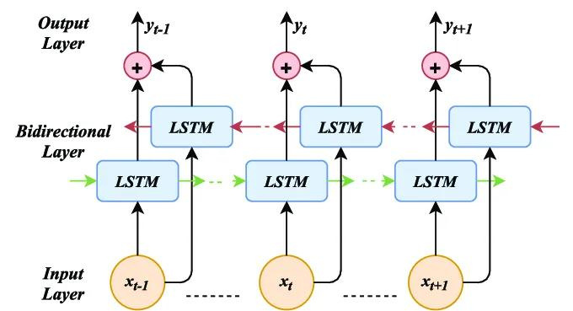
BIDIRECTIONAL LSTM

Slide 9
Pros and Cons of using Bidirectional- LSTM
Pros:
Captures long-term dependencies
Improved performance
Flexible architecture
Cons:
High computational cost
Requires large amounts of data
Difficult to interpret

Slide 10
Model Training and Evaluation
The model was trained on the preprocessed data for 5 epochs with Nadam optimizer and mean squared error loss function.
Evaluation metrics including Mean Squared Error (MSE), R-squared Score (R2), and Mean Absolute Error (MAE) were calculated to assess model performance.
Visualizations such as line plots, scatter plots, and histograms were employed to analyze model predictions, error distribution, and residuals.

Slide 11
CONCLUSION
The LSTM model demonstrated promising performance in predicting nitrate concentration based on water quality features.
Evaluation metrics indicated satisfactory model accuracy and reliability.
Further optimization and fine-tuning of the model could potentially enhance its predictive capabilities and applicability in real-world scenarios.

Slide 12
REFERENCES
Estimating fish weight growth in aquaponic farming through machine learning techniques
Evaluation of Nitrate Level in Green Lettuce Conventional Grown under Natural Conditions and Aquaponic System

Slide 13
YOUTUBE LINK
https://youtu.be/YS8iuM4XUuA

Slide 14

THANK YOU
PROJECT GUIDE
DR.SRI PHANI KRISHNA KARRI
TEAM MEMBERS
1.SAVADA RAKESH REDDY-521236
2.PANDALANENI MANIKANTA-521209
3.PEDDAPROLU PAVAN-521211

